Slide 1


Slide 2
Supertypes and Subtypes
Subtype: A subgrouping of the entities in an entity type that has attributes distinct from those in other subgroupings
Supertype: A generic entity type that has a relationship with one or more subtypes
Attribute Inheritance:
  Subtype entities inherit values of all attributes of the supertype
  An instance of a subtype is also an instance of the supertype

Slide 3
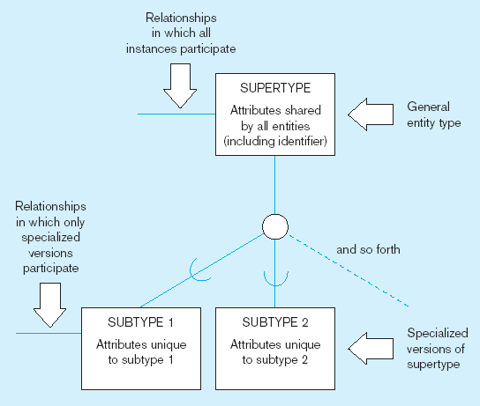
Figure 4-1 Basic notation for supertype/subtype notation
a) EER notation

Slide 4
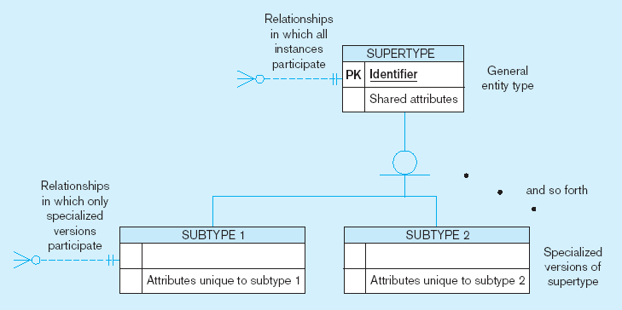
Figure 4-1 Basic notation for supertype/subtype notation (cont.)
b) Microsoft Visio Notation
Different modeling tools may have different notation for the same modeling constructs

Slide 5
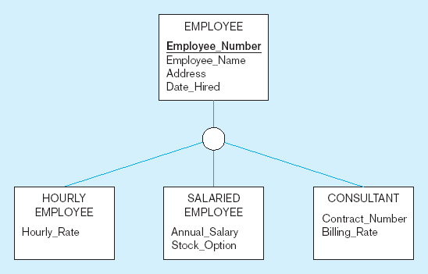
Figure 4-2 Employee supertype with three subtypes
All employee subtypes will have emp nbr, name, address, and date-hired
Each employee subtype will also have its own attributes

Slide 6
Relationships and Subtypes
Relationships at the supertype level indicate that all subtypes will participate in the relationship
The instances of a subtype may participate in a relationship unique to that subtype. In this situation, the relationship is shown at the subtype level

Slide 7
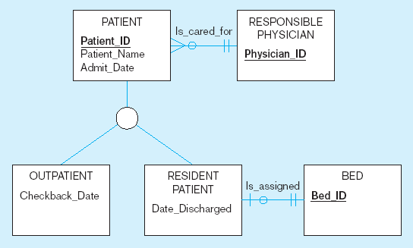
Figure 4-3 Supertype/subtype relationships in a hospital
Both outpatients and resident patients are cared for by a responsible physician
Only resident patients are assigned to a bed

Slide 8
create table Person
( Person_ID int primary key, Name varchar(100),
-- add some other common attributes (all of vendor, sponsor, volunteer have here. )
create table vendor
( vendor_ID int primary key, Person_ID int foreign key references Person(Person_ID)
-- add some other attributes related to vendor here. )
create table sponsor
( sponsor_ID int primary key, Person_ID int foreign key references Person(Person_ID)
-- add some other attributes related to sponsor here. )
create table volunteer
( volunteer_ID int primary key, Person_ID int foreign key references Person(Person_ID)
-- add some other attributes related to volunteer here. )

Slide 9
Generalization and Specialization
Generalization: The process of defining a more general entity type from a set of more specialized entity types. BOTTOM-UP
Specialization: The process of defining one or more subtypes of the supertype and forming supertype/subtype relationships. TOP-DOWN

Slide 10
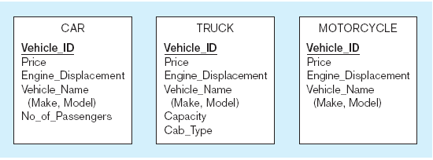
Figure 4-4 Example of generalization
a) Three entity types: CAR, TRUCK, and MOTORCYCLE
All these types of vehicles have common attributes

Slide 11
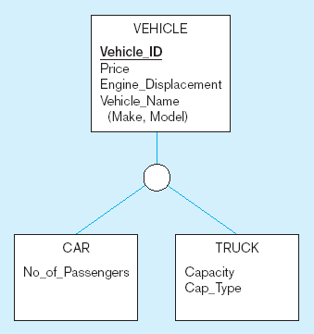
Figure 4-4 Example of generalization (cont.)
b) Generalization to VEHICLE supertype
So we put the shared attributes in a supertype
Note: no subtype for motorcycle, since it has no unique attributes

Slide 12
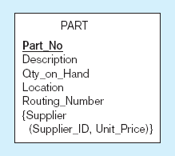
Figure 4-5 Example of specialization
a) Entity type PART
Only applies to manufactured parts
Applies only to purchased parts

Slide 13
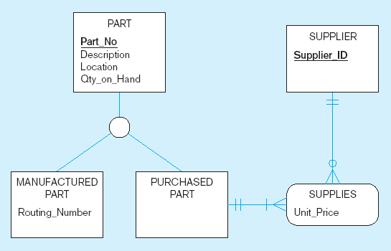
Figure 4-5 Example of specialization (cont.)
b) Specialization to MANUFACTURED PART and PURCHASED PART
Created 2 subtypes
Note: multivalued attribute was replaced by an associative entity relationship to another entity

Slide 14
Constraints in Supertype/ Completeness Constraint
Completeness Constraints: Whether an instance of a supertype must also be a member of at least one subtype
  Total Specialization Rule: Yes (double line)
  Partial Specialization Rule: No (single line)

Slide 15
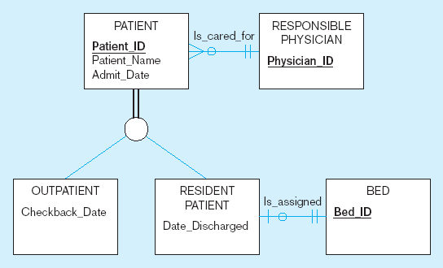
Figure 4-6 Examples of completeness constraints
a) Total specialization rule
A patient must be either an outpatient or a resident patient

Slide 16
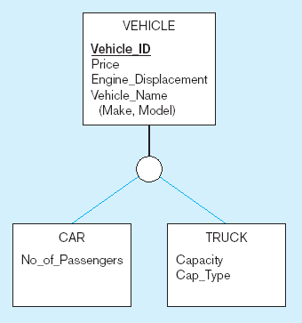
Figure 4-6 Examples of completeness constraints (cont.)
b) Partial specialization rule
A vehicle could be a car, a truck, or neither

Slide 17
Constraints in Supertype/ Disjointness constraint
Disjointness Constraints: Whether an instance of a supertype may simultaneously be a member of two (or more) subtypes
  Disjoint Rule: An instance of the supertype can be only ONE of the subtypes
  Overlap Rule: An instance of the supertype could be more than one of the subtypes

Slide 18
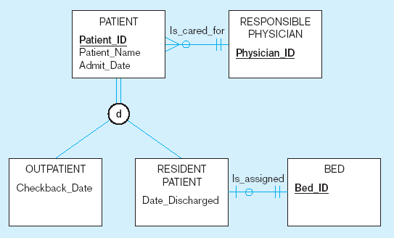
Figure 4-7 Examples of disjointness constraints
a) Disjoint rule
A patient can either be outpatient or resident, but not both

Slide 19
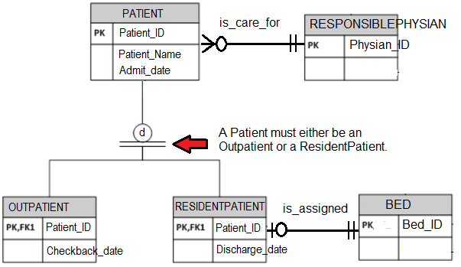

Slide 20
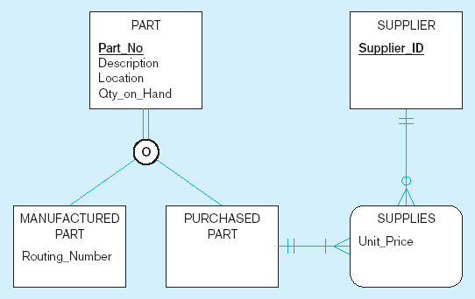
Figure 4-7 Examples of disjointness constraints (cont.)
b) Overlap rule
A part may be both purchased and manufactured

Slide 21
Constraints in Supertype/ Subtype Discriminators
Subtype Discriminator: An attribute of the supertype whose values determine the target subtype(s)
  Disjoint – a simple attribute with alternative values to indicate the possible subtypes
  Overlapping – a composite attribute whose subparts pertain to different subtypes. Each subpart contains a boolean value to indicate whether or not the instance belongs to the associated subtype

Slide 22
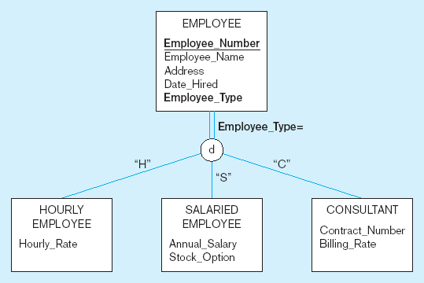
Figure 4-8 Introducing a subtype discriminator (disjoint rule)
A simple attribute with different possible values indicating the subtype

Slide 23
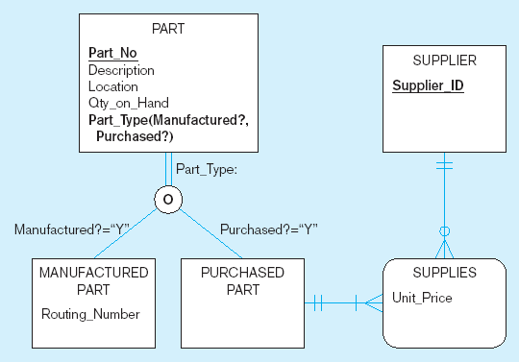
Figure 4-9 Subtype discriminator (overlap rule)
A composite attribute with sub-attributes indicating “yes” or “no” to determine whether it is of each subtype

Slide 24
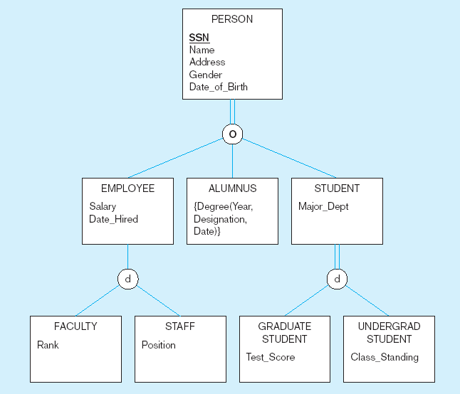
Figure 4-10 Example of supertype/subtype hierarchy

Slide 25
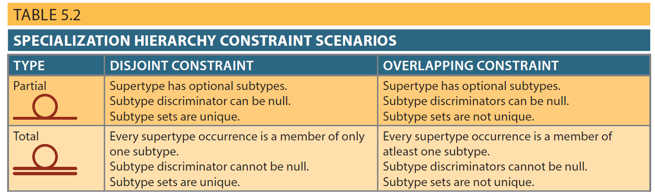

Slide 26
Entity Clusters
EER diagrams are difficult to read when there are too many entities and relationships
Solution: Group entities and relationships into entity clusters
Entity cluster: Set of one or more entity types and associated relationships grouped into a single abstract entity type

Slide 27
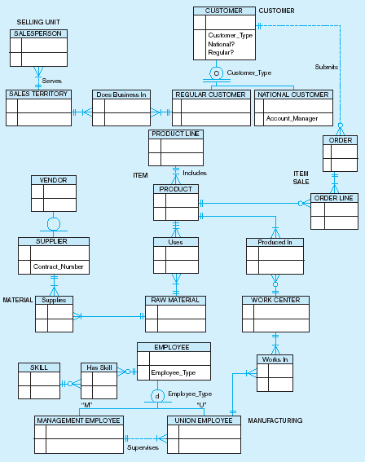
Figure 4-13a Possible entity clusters for Pine Valley Furniture in Microsoft Visio
Related groups of entities could become clusters

Slide 28
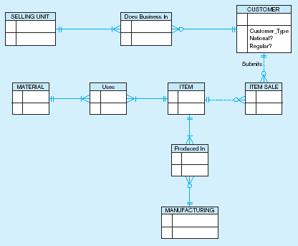
Figure 4-13b EER diagram of PVF entity clusters
More readable, isn’t it?

Slide 29
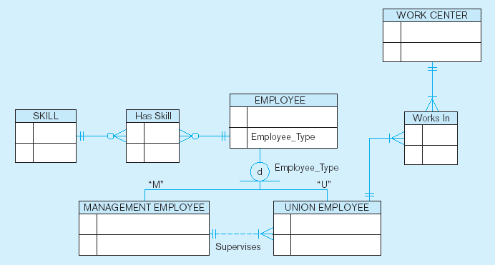
Figure 4-14 Manufacturing entity cluster
Detail for a single cluster

Slide 30
Primary Keys
Single attribute or a combination of attributes, which uniquely identifies each entity instance
  Guarantees entity integrity
  Works with foreign keys to implement relationships

Slide 31
Natural Keys or Natural Identifier
Real-world identifier used to uniquely identify real-world objects
  Familiar to end users and forms part of their day-to-day business vocabulary
  Also known as natural identifier
  Used as the primary key of the entity being modeled

Slide 32
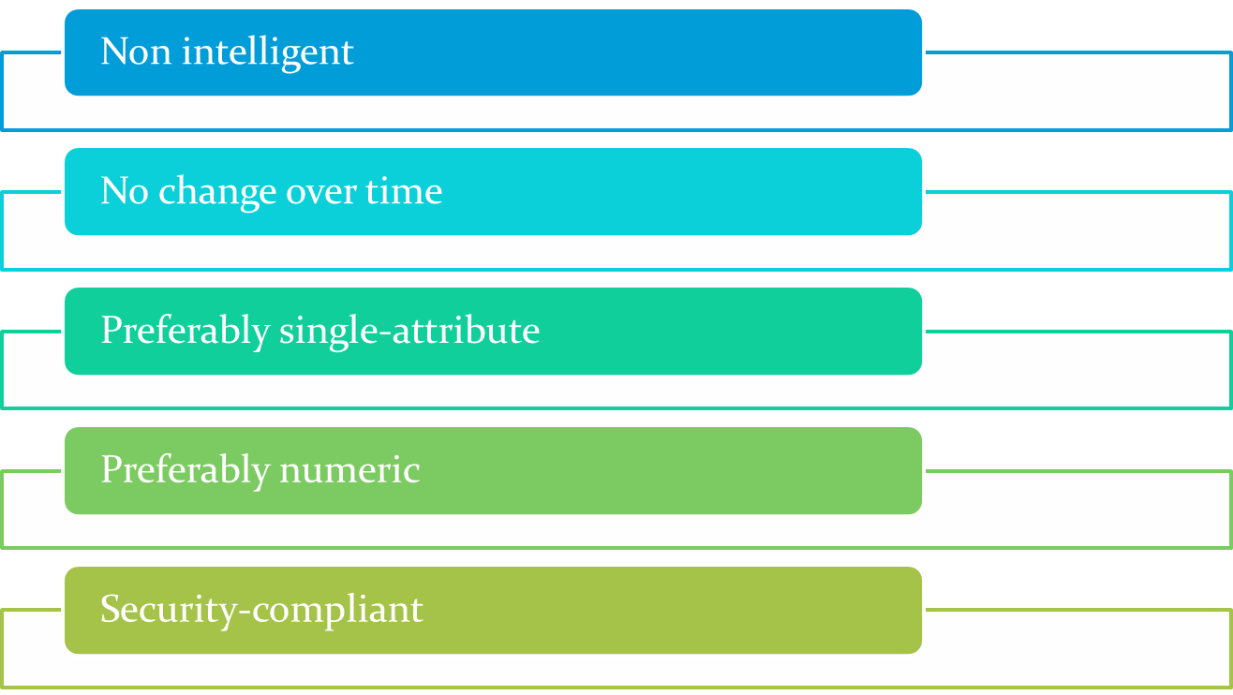
Desirable Primary Key Characteristics

Slide 33
Use of Composite Primary Keys
Identifiers of composite entities
  Each primary key combination is allowed once in M:N relationship
Identifiers of weak entities
  Weak entity has a strong identifying relationship with the parent entity

Slide 34
Use of Composite Primary Keys
When used as identifiers of weak entities, represent a real-world object that is:
  Existence-dependent on another real-world object
  Represented in the data model as two separate entities in a strong identifying relationship

Slide 35
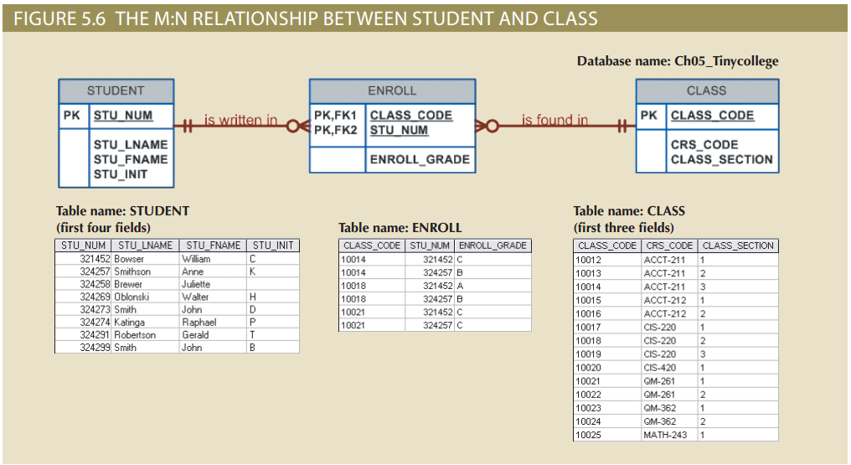
The M:N Relationship between STUDENT and CLASS

Slide 36
Surrogate Primary Keys
Primary key used to simplify the identification of entity instances are useful when:
  There is no natural key
  Selected candidate key has embedded semantic contents or is too long
Require ensuring that the candidate key of entity in question performs properly
  Use unique index and not null constraints

Slide 37
Design Case 1: Implementing 1:1 Relationships
Foreign keys work with primary keys to properly implement relationships in relational model
Rule
  Put primary key of the parent entity on the dependent entity as foreign key
Options for selecting and placing the foreign key:
  Place a foreign key in both entities
  Place a foreign key in one of the entities

Slide 38
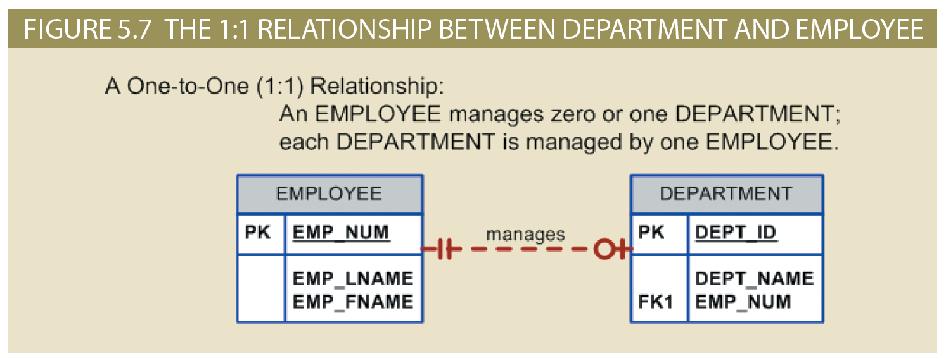
The 1:1 Relationship between Department and Employee

Slide 39
Design Case 2: Maintaining History of Time-Variant Data
Time-variant data: Data whose values change over time and for which a history of the data changes must be retained
  Requires creating a new entity in a 1:M relationship with the original entity
  New entity contains the new value, date of the change, and other pertinent attribute

Slide 40
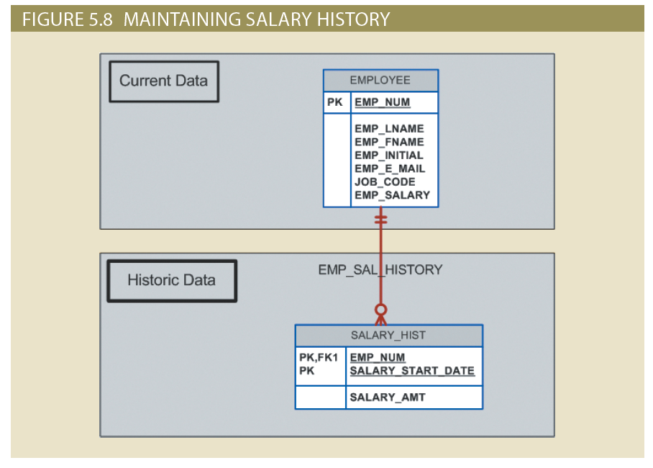
Figure 5.8 - Maintaining Salary History

Slide 41
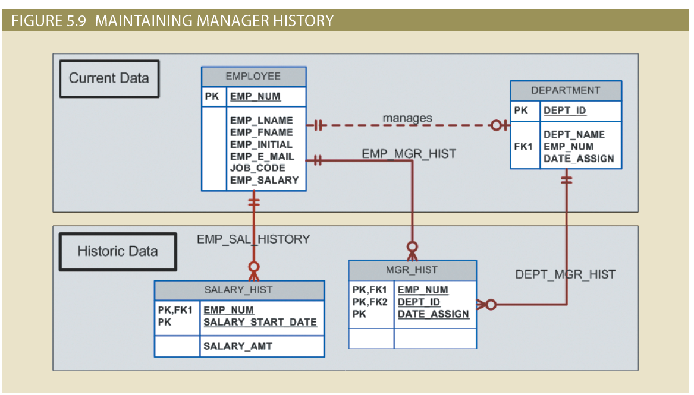
Maintaining Manager History

Slide 42
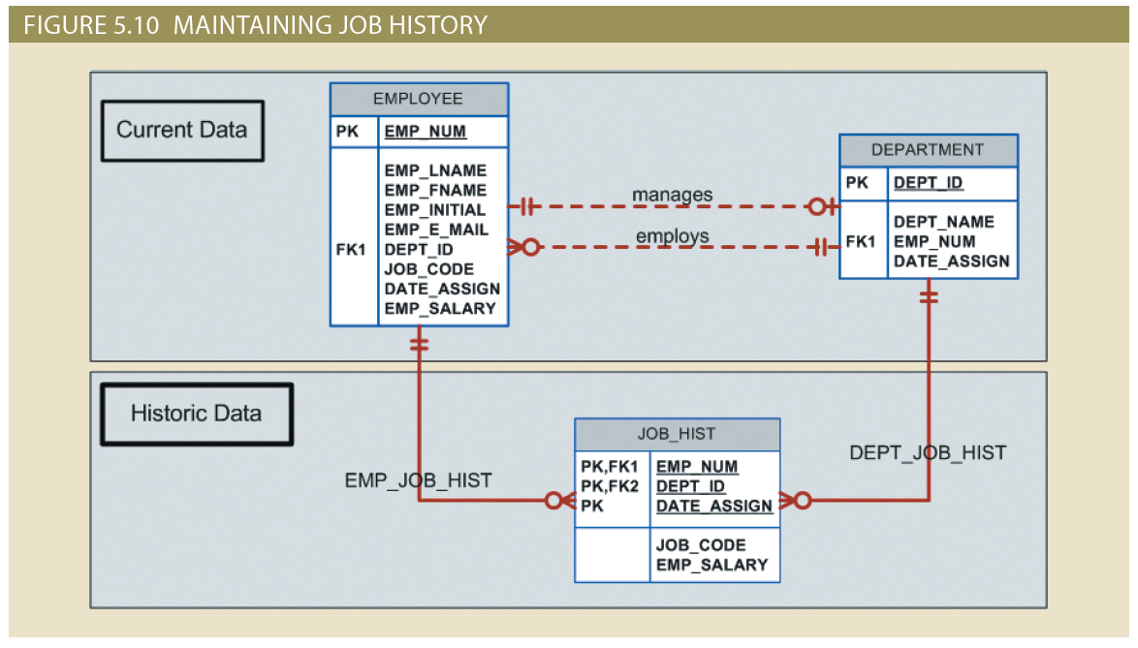
Figure 5.10 - Maintaining Job History

Slide 43
Design Case 3: Fan Traps
Design trap: Occurs when a relationship is improperly or incompletely identified
  Represented in a way not consistent with the real world
Fan trap: Occurs when one entity is in two 1:M relationships to other entities
  Produces an association among other entities not expressed in the model

Slide 44
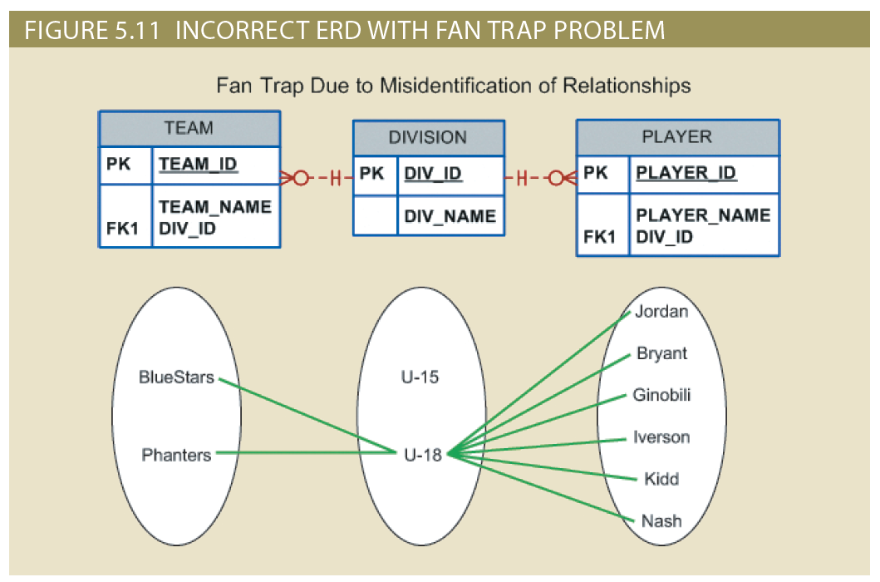
Incorrect ERD with Fan Trap Problem

Slide 45
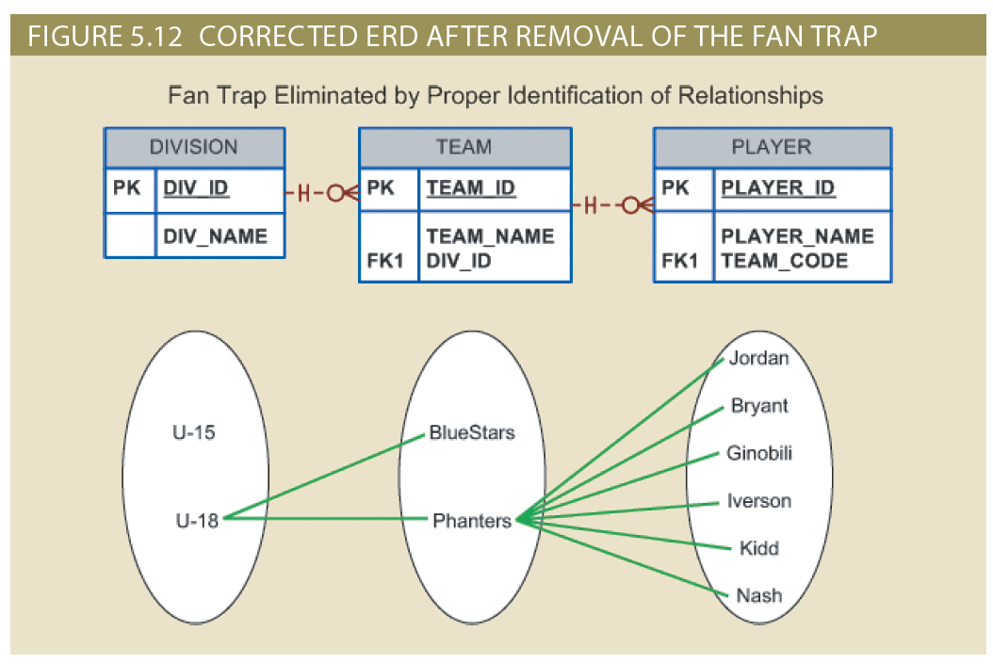
Corrected ERD After Removal of the Fan Trap

Slide 46
Design Case 4:
Redundant Relationships
Occur when there are multiple relationship paths between related entities
Need to remain consistent across the model
Help simplify the design

Slide 47
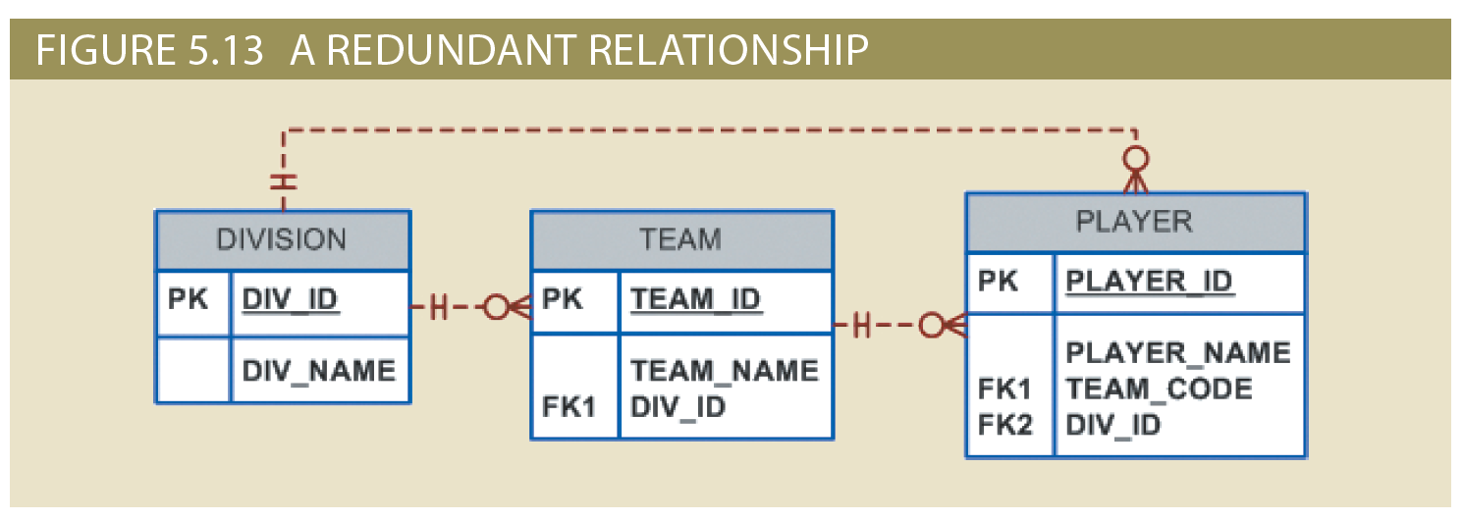
A Redundant Relationship

